Slide 1
Homework 10 Customer Movement Analysis
BADS7105 CRM Analytics and Intelligence
Korrapin Pimapansri

Slide 2
Type of Customer
Type | Purchased period
Type | This month | Previous month | 2 months ago
New
Repeat
Reactive
Churn

Slide 3
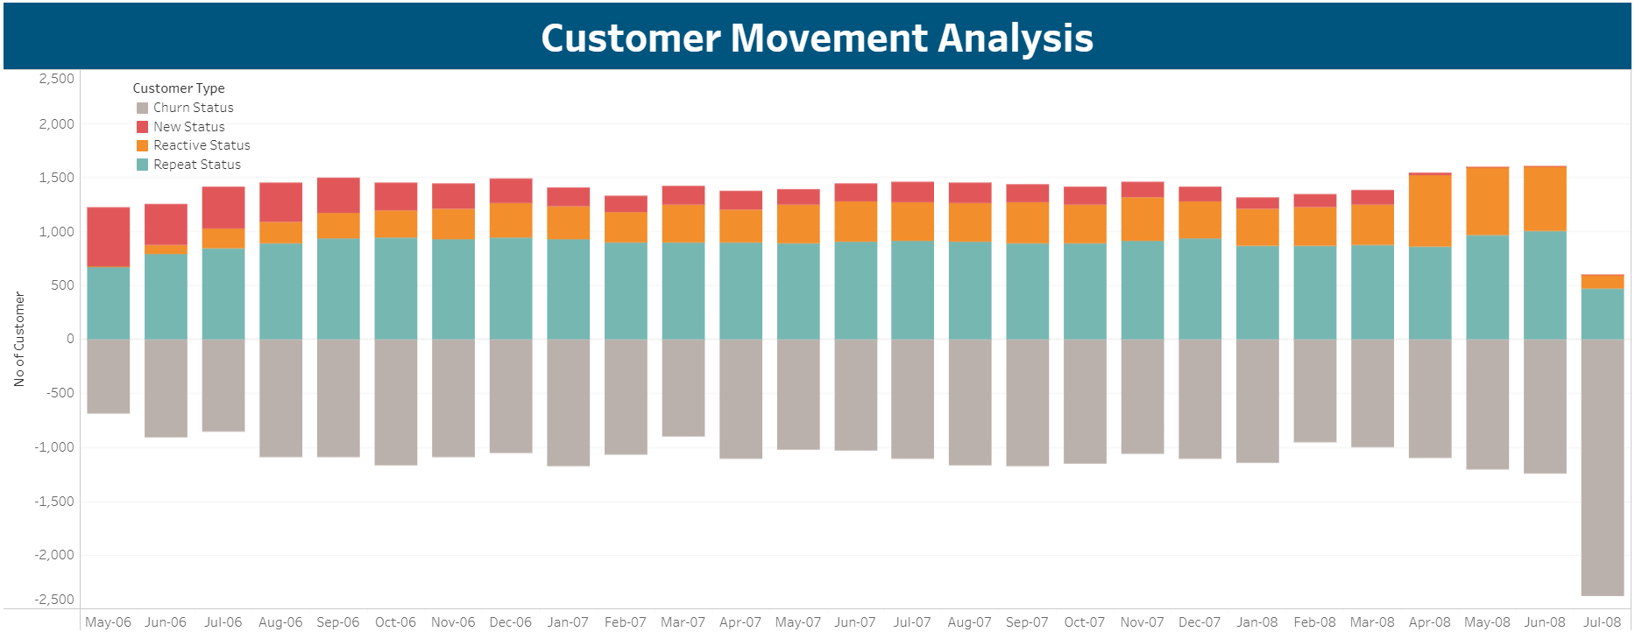
https://public.tableau.com/views/BADS7105-CustomerMovement/CustomerMovementAnalysis?:language=en-US&:display_count=n&:origin=viz_share_link

